Slide 1
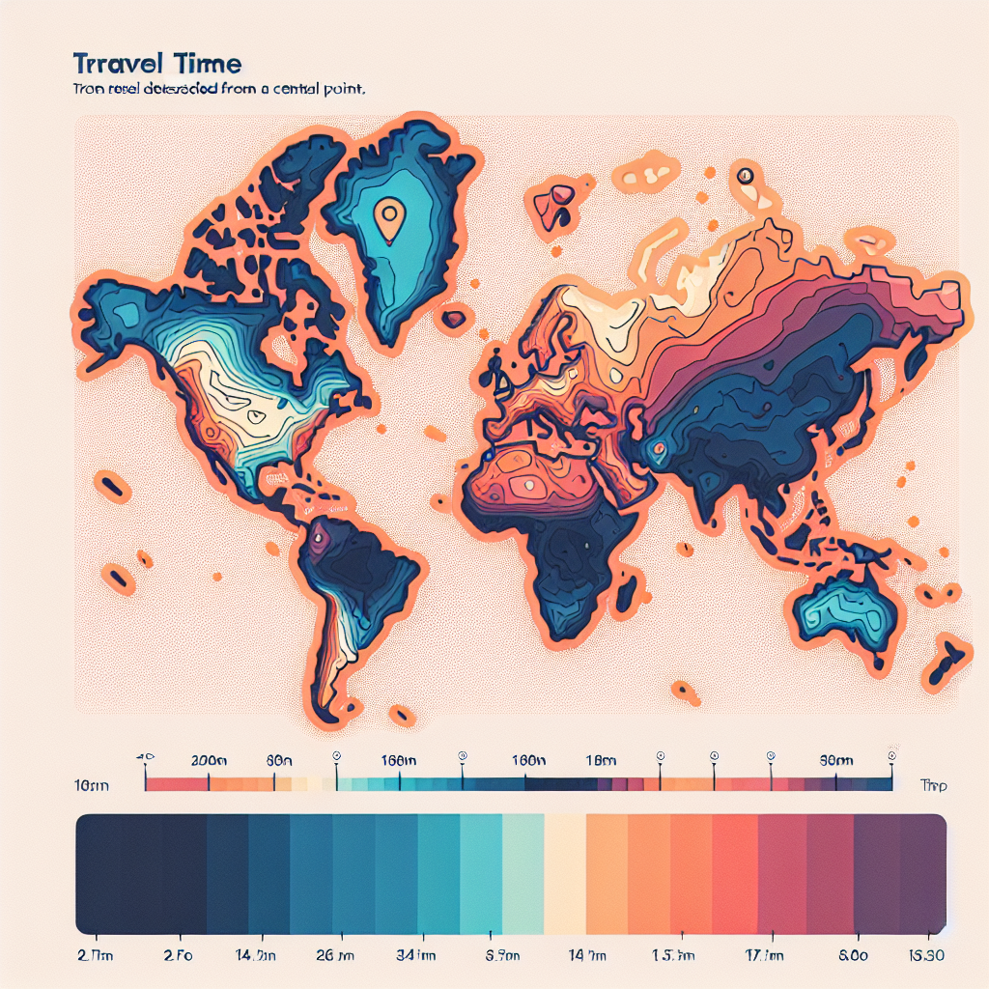

What Is a 15‑Minute City?
Definition: A planning framework that clusters daily needs—home, work, learning, care, groceries, parks—within a 15‑minute walk or bike ride, prioritizing proximity, safety, and choice.
Proximity: short trips to essentials
Diversity: mixed uses and housing types
Density done well: enough people to support services
Complete networks: safe, continuous walking/cycling/transit
Human‑scaled streets: slower speeds, greener public realm
Digital/physical integration: delivery lockers, telehealth, coworking
Participatory governance: neighborhood co‑design
Equity: invest first where access gaps are largest
Climate resilience: shade, stormwater, low‑carbon mobility

